Slide 1


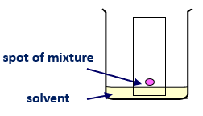
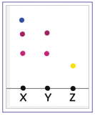
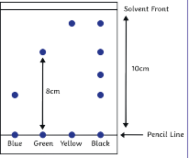
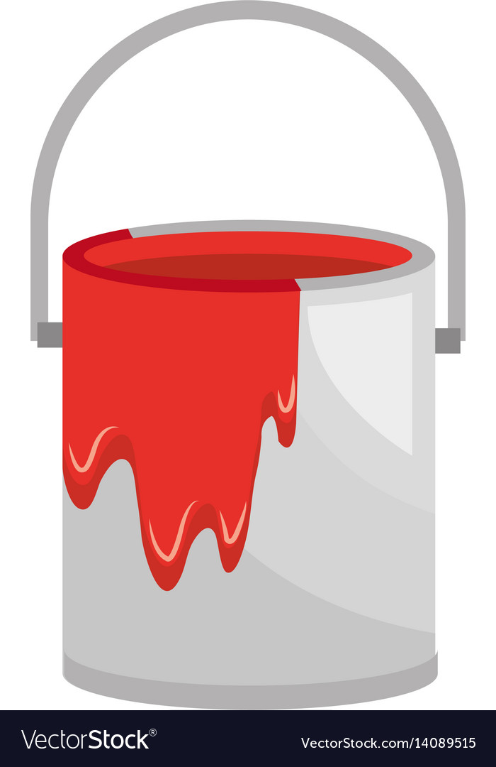
C8 – Chemical Analysis
Pure substances
Pure = single element or
compound – not mixed with
any other substance.
Testing to see if a substance is pure:
- Pure substances have specific melting and boiling points
- Compare your data to a library of known values.
E.g. Water has a boiling point of 100ºC, if it is above or below this, it is not pure.
Chromatography
- Technique used to separate mixtures of soluble substances.
- How soluble a substance is determines how far it travels across paper.
More soluble = travels further (higher up paper)
Mobile phase
- Solvent is the mobile phase
- The substances dissolve in the
solvent
The solvent then moves through the stationary phase.
Stationary phase
- Does not move. The paper is the stationary phase.
Important – start line on paper must be drawn in pencil as pencil is insoluble and will not run
The spot and start line must be above the solvent line so the colours won’t just wash into the solvent in the beaker.
Rf Values
This is the ratio of the distance moved by a substance to the distance moved by the compound
- Should always be between 0 and 1.
- Each substance has a unique Rf value.
- Can compare Rf values to a library of known substances
- Can identify unknown substances.
Rf value of green:
8cm / 10cm = 0.8
Formulations
Formulation = a mixture that is designed as a useful product.
- Components mixed carefully to get the required properties.
Examples of formulations:
- Fuels
- Cleaning agents
- Paints
- Medicines
- Alloys
- Fertilisers
- Food
Y is a mixture as
it contains
2 substances
(2 spots)
X is a mixture as
it contains
3 substances
(3 spots)
Z is pure as it
only contains
one substance
(1 spot)
Three samples
(x, y and z)

Slide 2
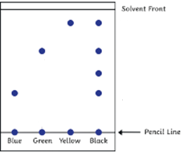
C8 – Chemical Analysis
What is a pure substance?
How can you test that a substance is pure?
What is chromatography used for?
What determines how far the substance travels?
What is the mobile phase in paper chromatography?
What is the stationary phase in paper chromatography?
How would you be able to identify a pure substance on a chromatogram?
Draw and label a diagram of the experiment to Investigate how many different colours there are in food colouring using paper chromatography.
How do you calculate the Rf value?
Rf values should always be between…
Use a ruler to measure the distance the solvent moved in the diagram below.
Use a ruler to measure how far the yellow spot moved
Calculate the Rf value for yellow
What is a formulation?
Give 3 examples of formulations.

Slide 3


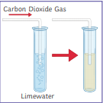

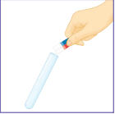
C8 – Chemical Analysis
Required Practical – Paper Chromatography
Aim: Investigate how paper chromatography can be used to separate and distinguish between coloured substances.
Method
1) Using a ruler, measure 1cm from bottom of chromatography paper and draw a line across the paper with a pencil.
2) Using a pipette, drop small spots of each ink onto pencil line (leave a gap so do not merge).
3) Pour solvent into a beaker, do not fill solvent above the pencil line on the paper.
4) Place chromatograph paper into beaker and allow solvent to move up the paper.
5) Remove paper just before solvent reaches top of the paper and leave to dry.
6) Calculate R_{f} values of all the spots using the equation below:
Common questions
Q1) Why is a pencil used instead of a pen?
A1) Ink in the pen would move up the paper with the substances.
Q2) Why do you not fill the solvent above the line?
A2) Substances would wash off into the solvent instead of rising up the paper
Q3) Why might water not work as a solvent?
A3) Some substances are insoluble in water.
Identification of the Common Gases
Test for hydrogen – Place a burning splint at the opening of a test tube.
If hydrogen gas is present, it will burn with a squeaky-pop sound.
Test for Oxygen – Place a glowing splint inside a test tube.
The splint will relight in the presence of oxygen.
Test for Carbon Dioxide –Bubble the gas through the lime water
– if the gas is carbon dioxide, the limewater turns cloudy.
Test for Chlorine – Damp litmus paper is held over the of gas. If the tube contains chlorine, the litmus paper
becomes bleached and turns white.

Slide 4
C8 – Chemical Analysis
Describe how you would carry out paper chromatography to separate and identify the different colours in food dye.
Why is a pencil used instead of a pen?
Why do you not fill the solvent above the pencil line?
Why might water not work as a solvent?
Describe the tests and the positive results for:
a) Hydrogen
b) Carbon dioxide
c) Oxygen
d) Chlorine

